Slide 1
Model | WAIC | ΔWAIC
DeadVeg + GrassForb + HostDiversity | 81.89547 | 0
HostDiversity | 82.21863 | 0.323162
DeadVeg + HostDiversity | 82.54373 | 0.648257
DeadVeg + GrassForb + HostAbundance | 82.85163 | 0.956164
DeadVeg + GrassForb | 82.86471 | 0.969241
Full | 83.84471 | 1.949244
DeadVeg + HostAbundance | 84.00308 | 2.107609
GrassForb + HostAbundance + HostDiversity | 84.06994 | 2.174477
…
HostAbundance + HostDiversity | 85.25563 | 3.360158
GrassForb + HostDiversity | 87.13294 | 5.237473

Slide 2
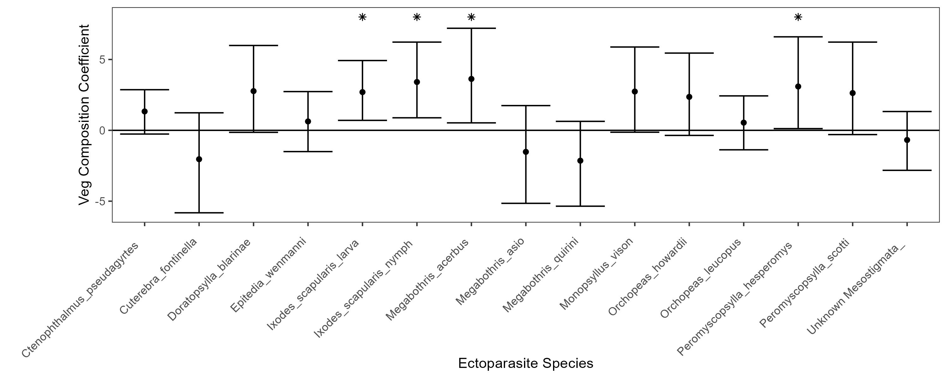

Slide 3
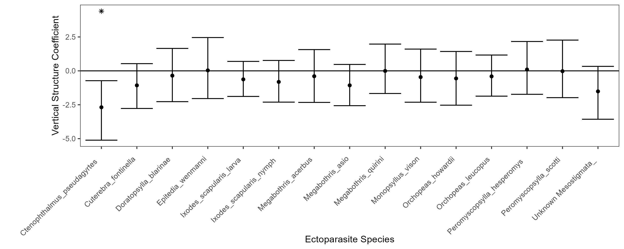

Slide 4
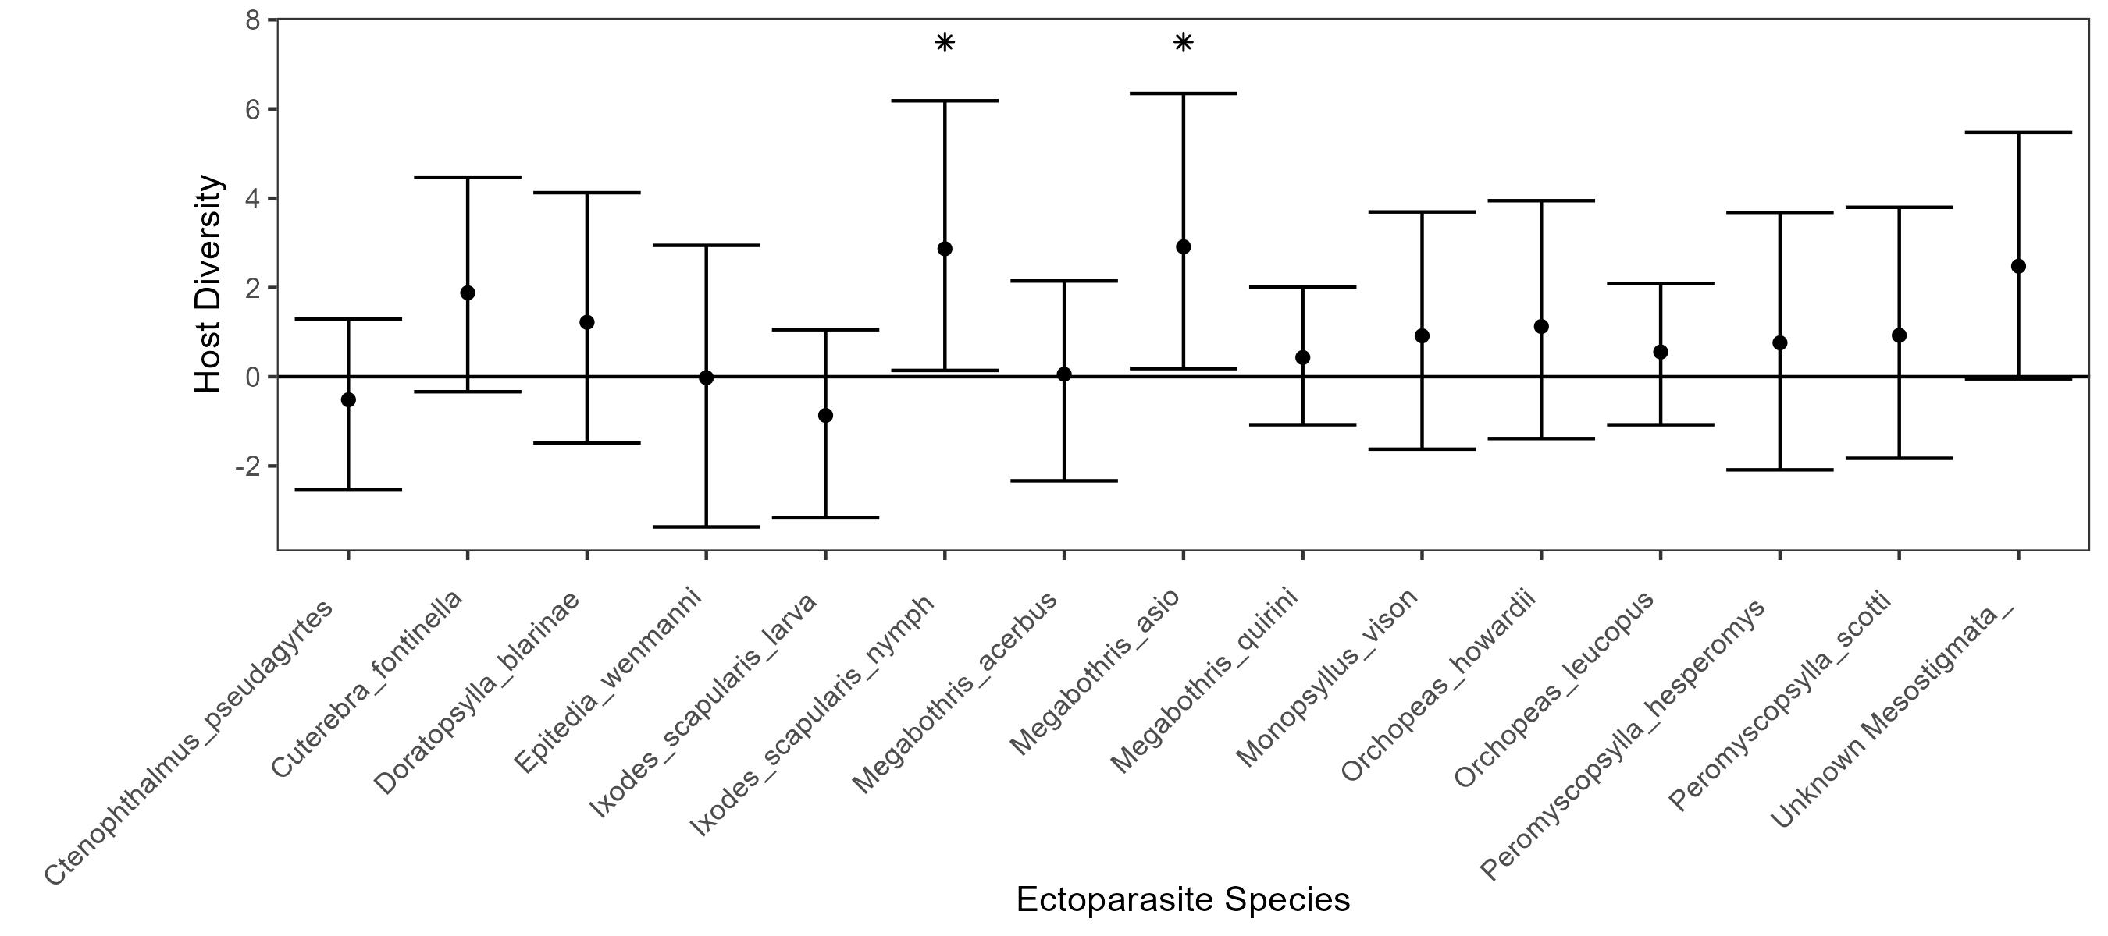

Slide 5
Model | WAIC | ΔWAIC
Mass + Sex | 73.95967 | 0
Mass | 78.01522 | 4.055549
Sex | 78.27622 | 4.316551
Species + Mass | 83.47169 | 9.512025
Species + Mass + Interaction | 83.60058 | 9.640912
Species + Sex + Interaction | 83.7635 | 9.803835
…
Sex + Interaction | 86.08672 | 12.12705
Species + Sex | 86.44847 | 12.4888
Mass + Interaction | 86.86413 | 12.90446

Slide 6
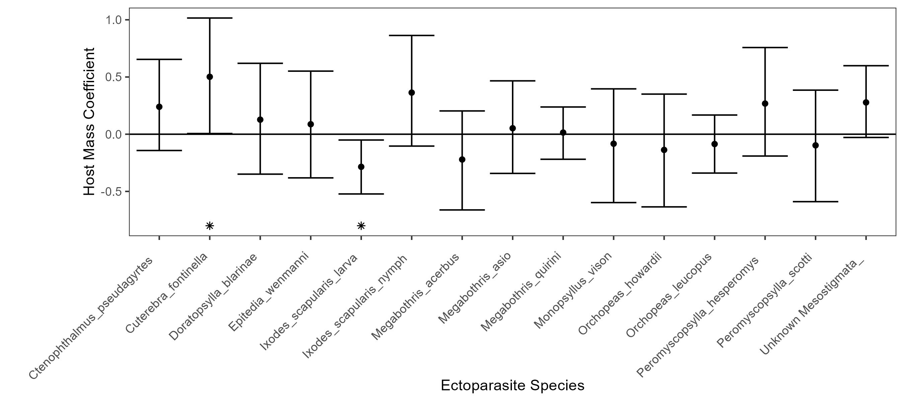

Slide 7
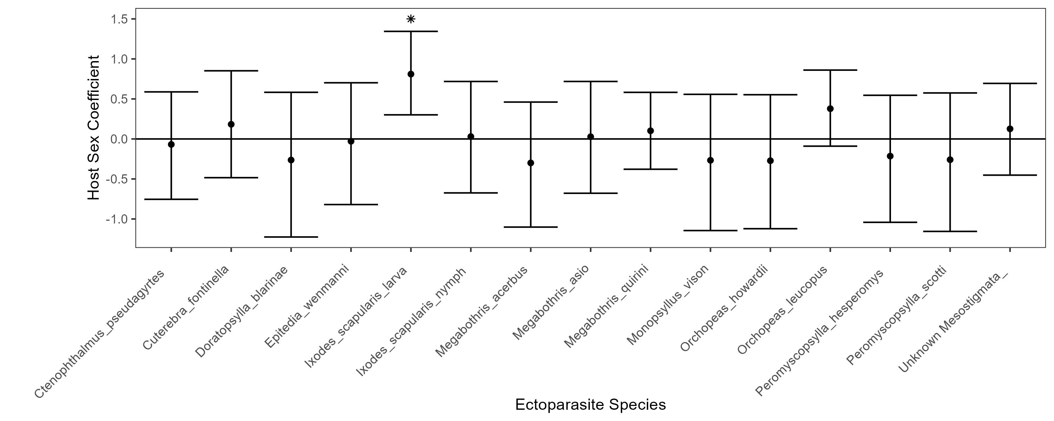

Slide 8
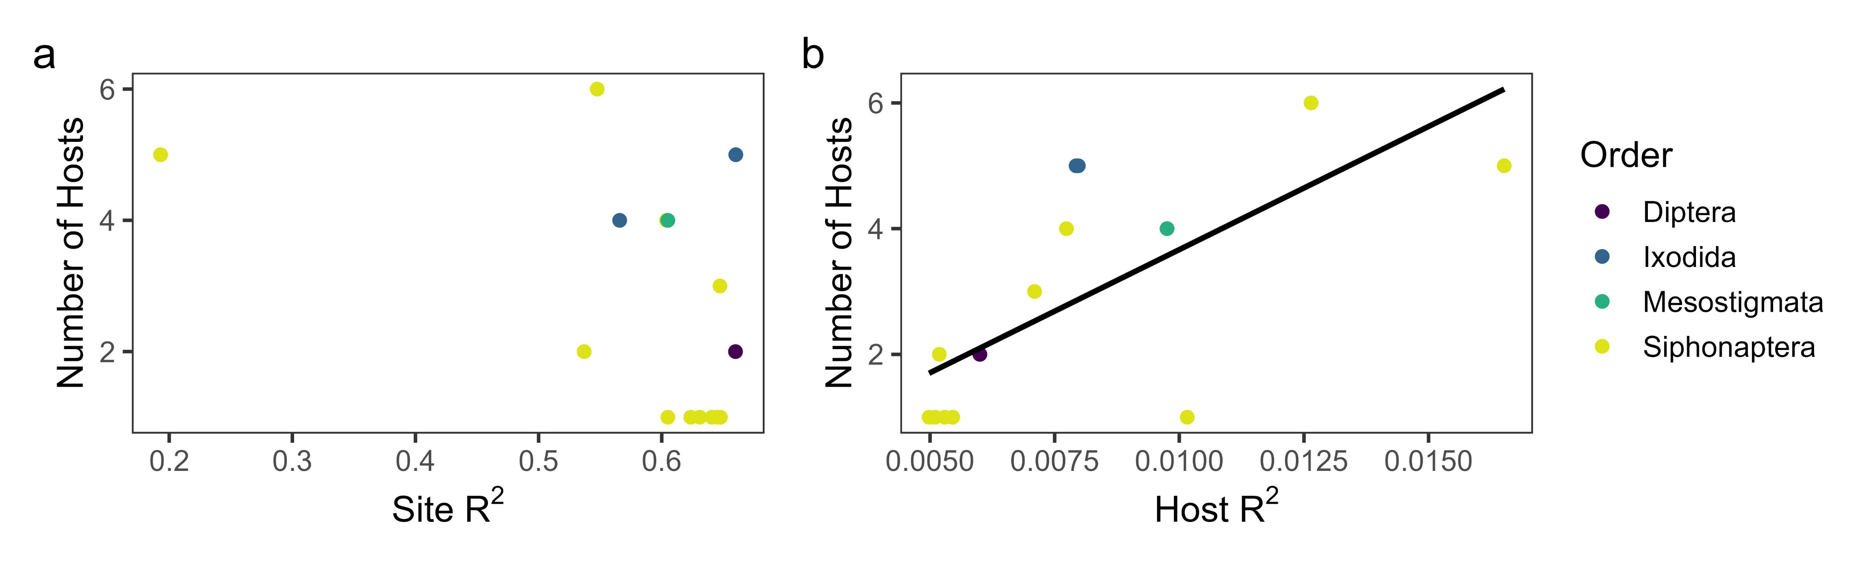

Slide 9
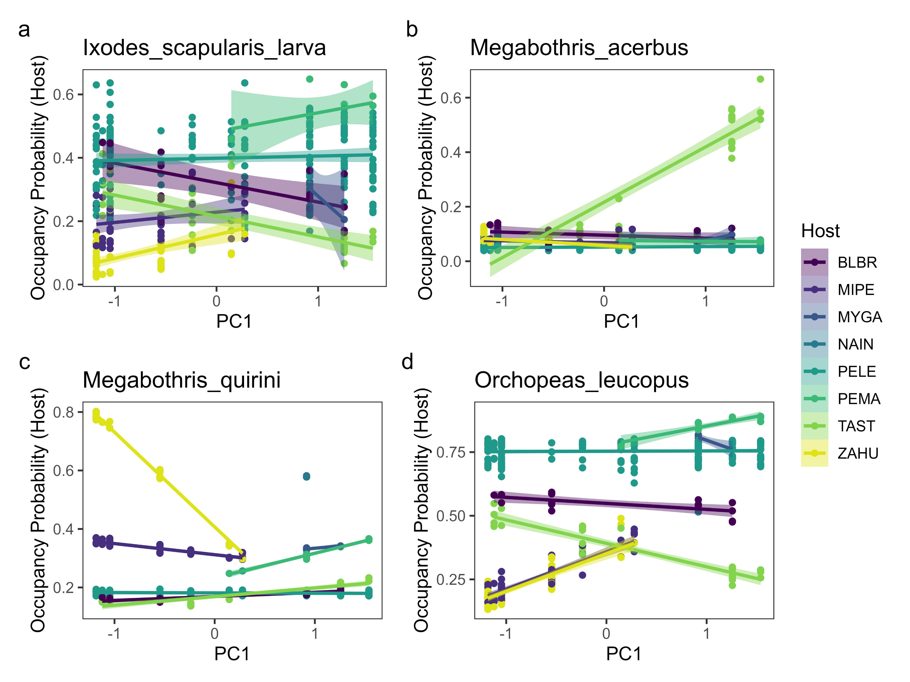

Slide 10
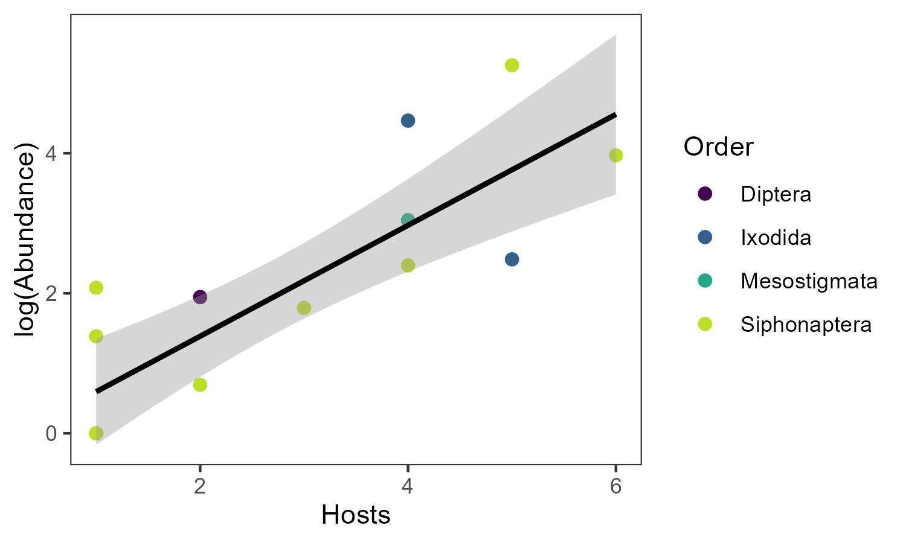

Slide 11
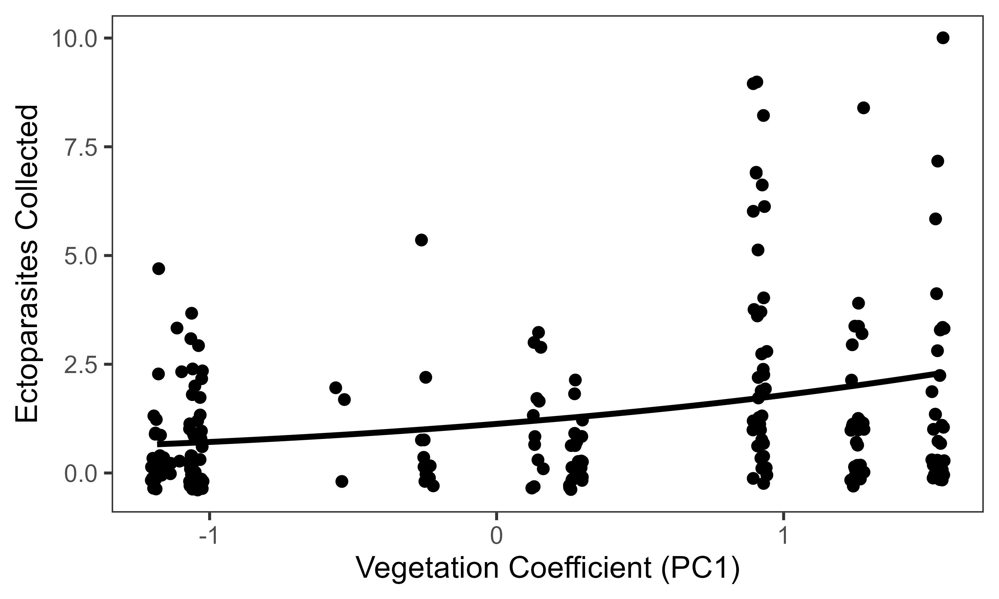

Slide 12
